Slide 1

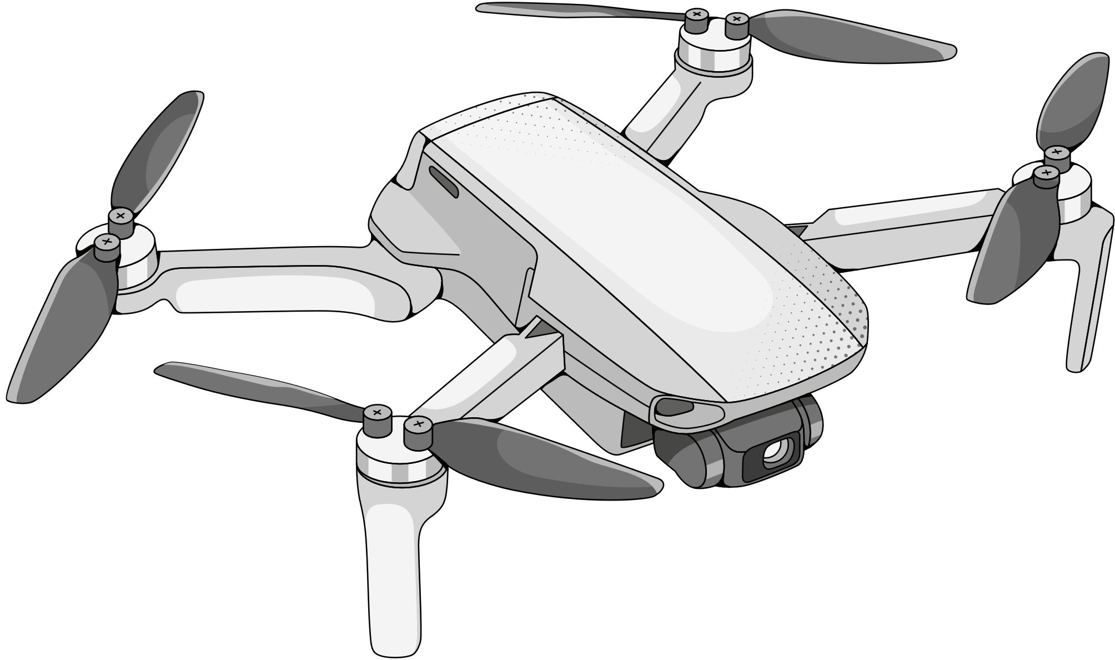

Drones for computer vision applications
Lukas Beierl, Erwin Grenz, Nadir Hussain
Group 3
(Summer School), (E24)
16.08.2024

Slide 2
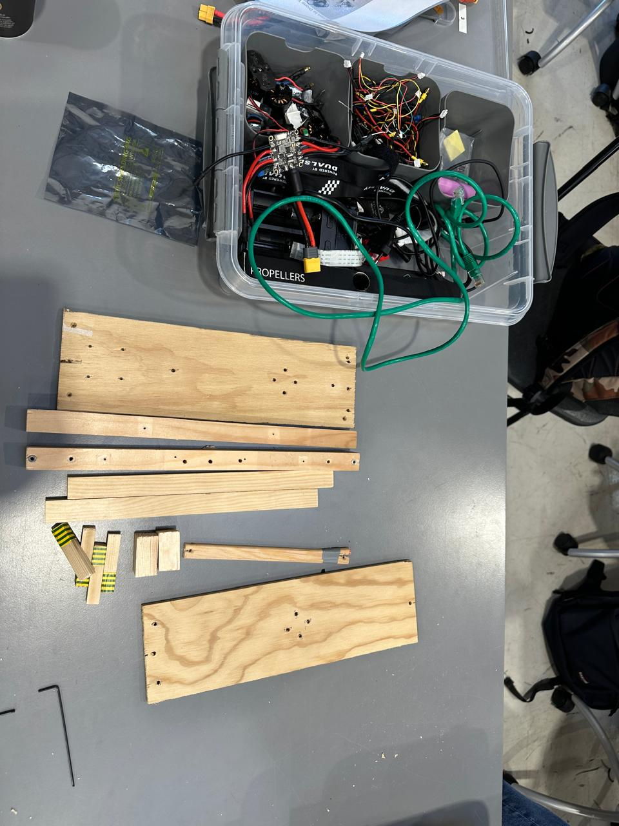
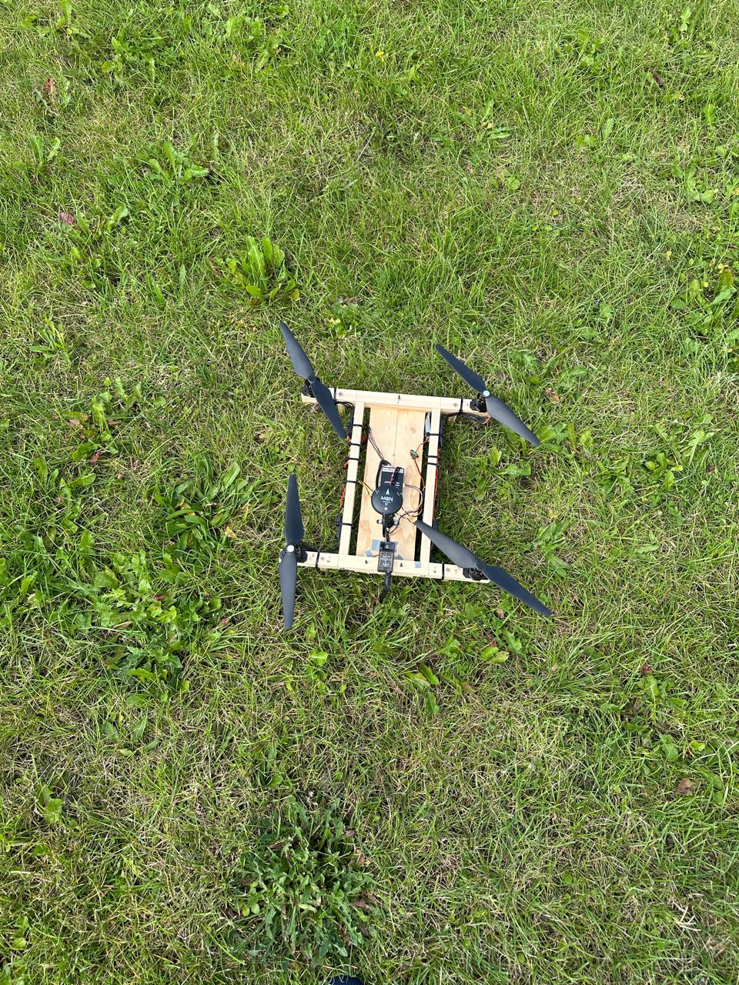
1.Introduction
Build and fly drone From pieces of Wood and tools
Gather information(log)
Understand how to use that information to solve. real-world problems.
Learn about drone safety
How to program drones.
and think about the impact drones have on people.
Slide 1 Group 3 – 16.08.2024

Slide 3
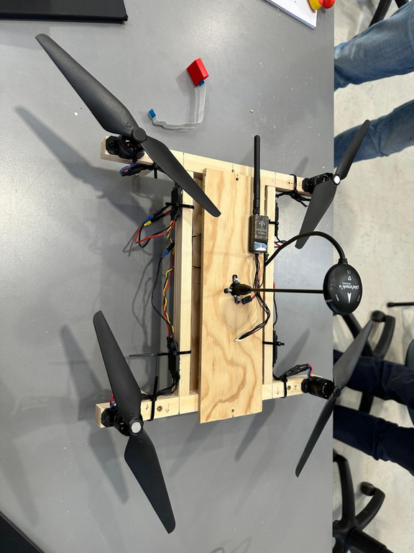
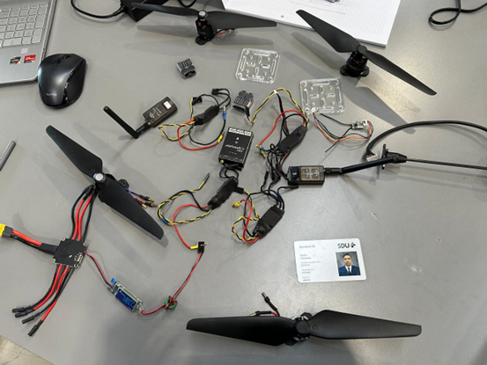
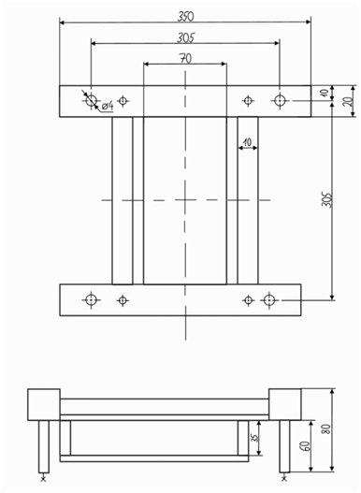
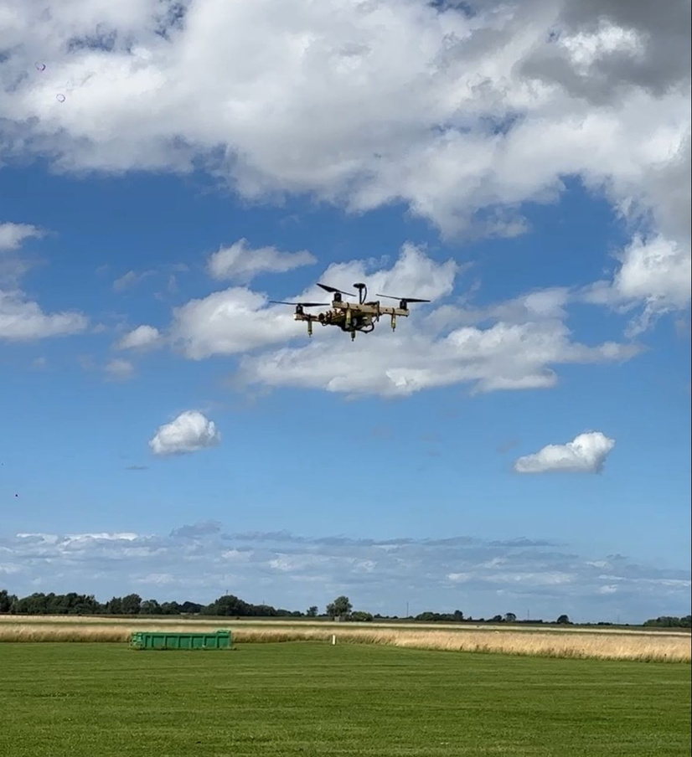

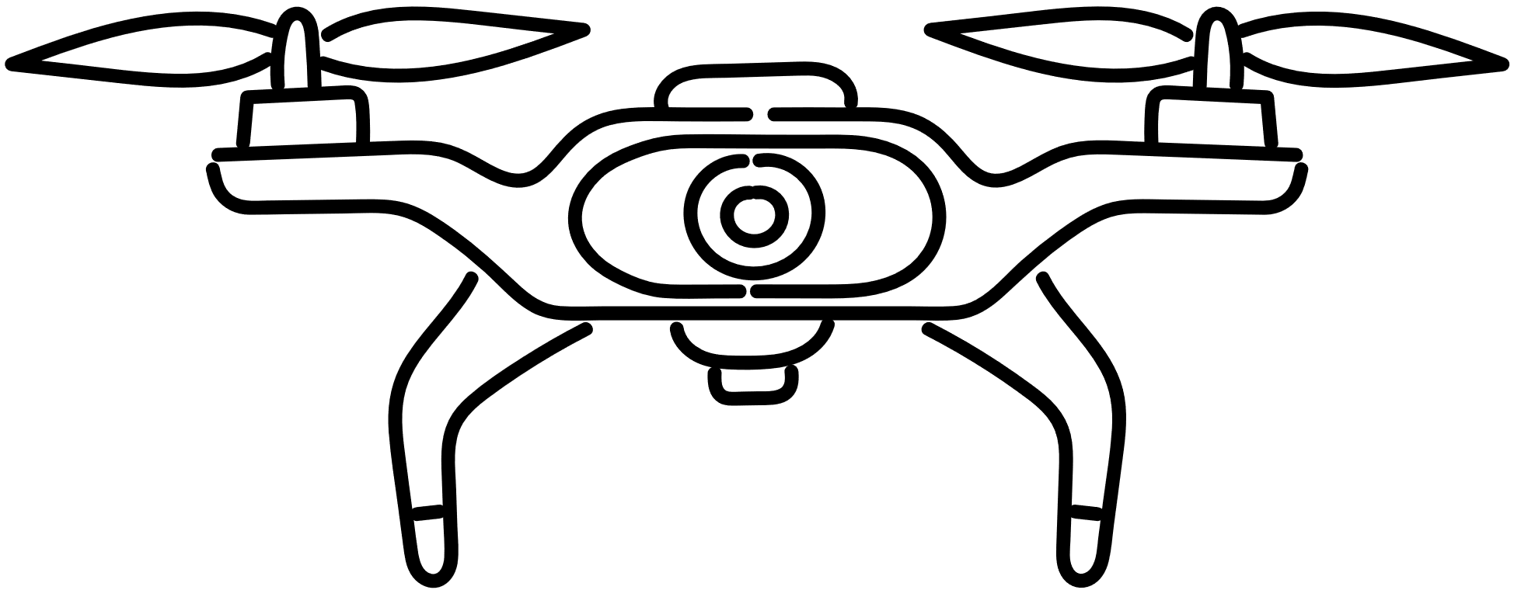
2.Construction
H-Type
Slide 2 Group 3 – 16.08.2024

Slide 4

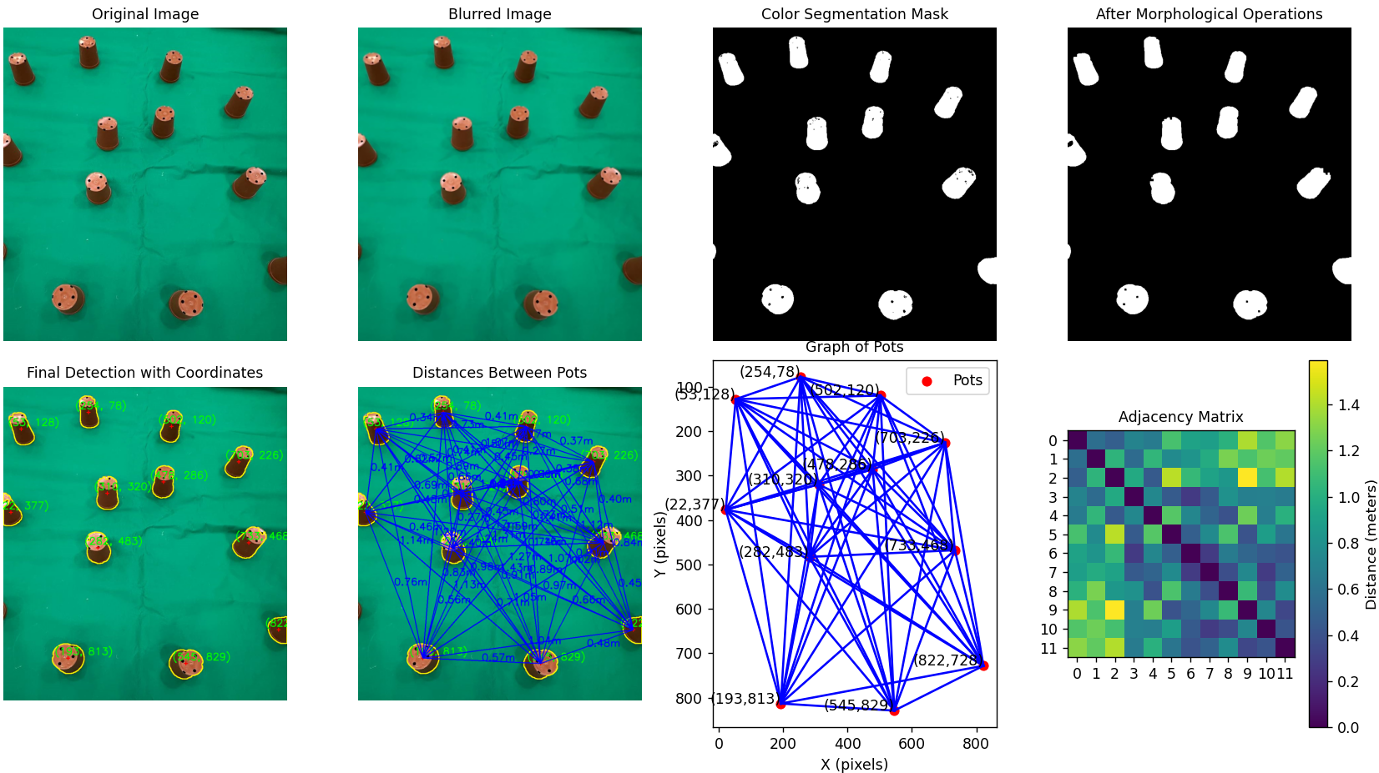
Computer vision
Example
Github: https://github.com/GIT057/Drones-for-Computer-Vision-applications
Slide 3 Group 3 – 16.08.2024

Slide 5
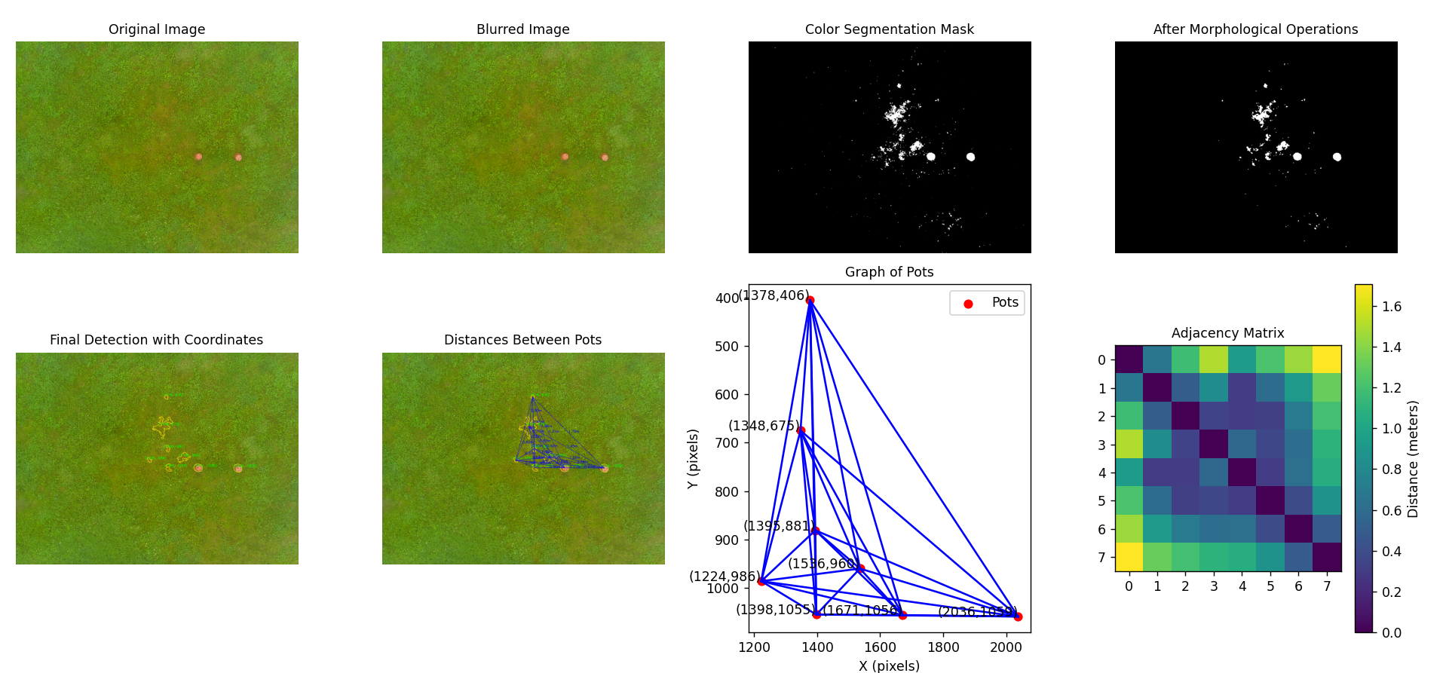
Computer vision
Example – False positiv detections with drone pictures due to dirt and sand
Github: https://github.com/GIT057/Drones-for-Computer-Vision-applications
Slide 4 Group 3 – 16.08.2024

Slide 6
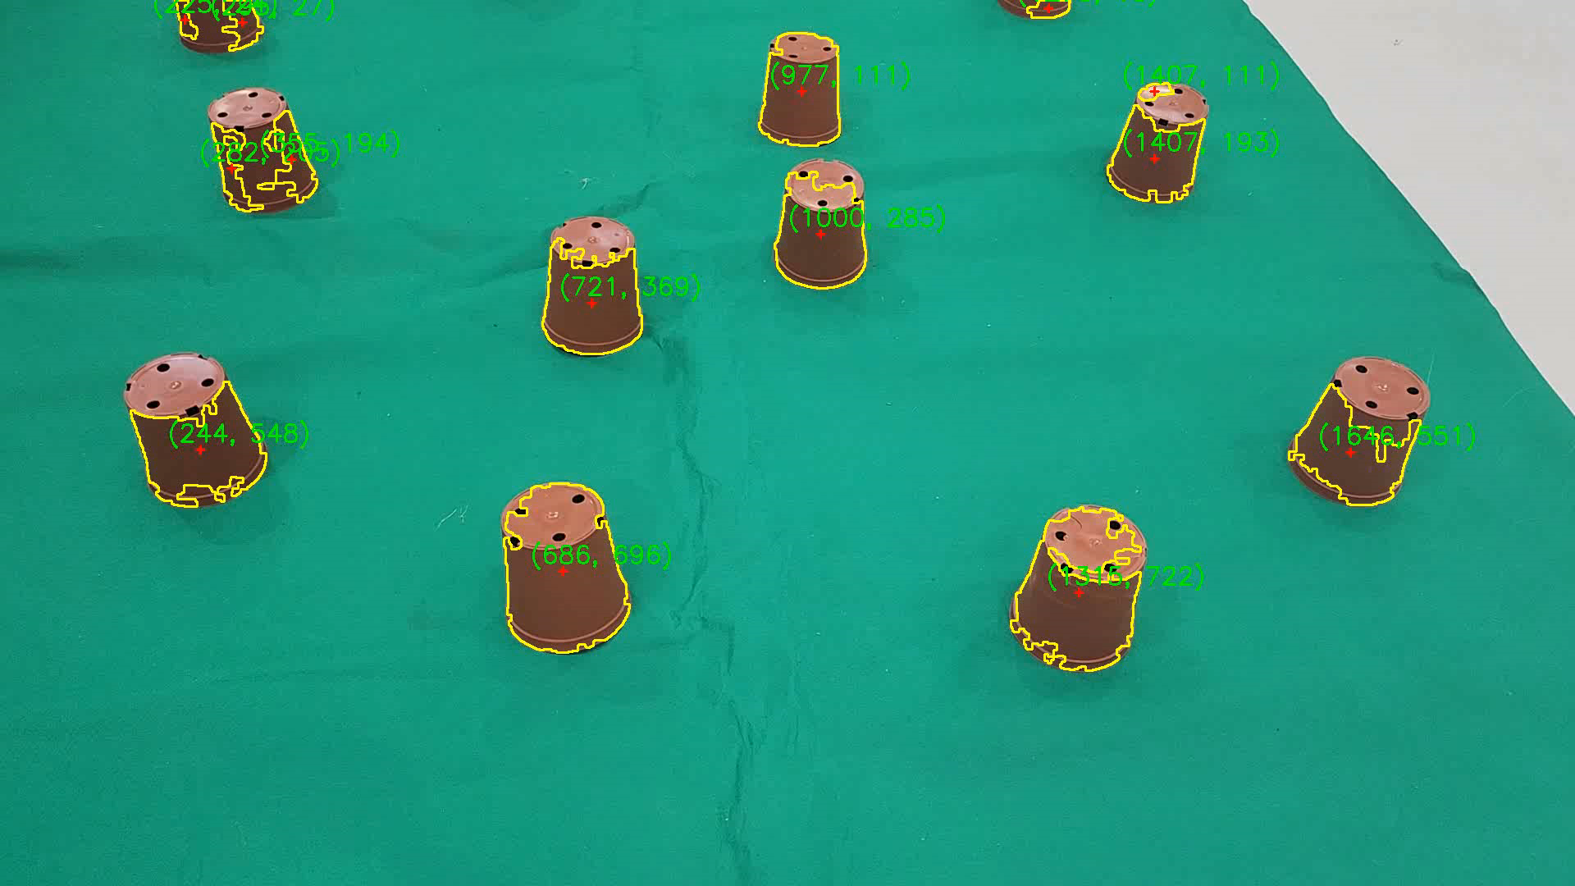
Computer vision
Video – example
Slide 5 Group 3 – 16.08.2024

Slide 7
Summary
Lessons learned – reflections
Category | Advantages (+) | Disadvantages (-) | → Improvements
Mechanics/ Design | Easy construction assembly | Not perpendicular | Use tools for adjustment
Mechanics/ Design | Much space in the center | Airflow gets blocked | Longer Arms
Mechanics/ Electronics | Easy wiring due to much space | Loose connection of receiver → Communication problems | Fix the electric connections and wires better
Software Engineering/ Computer Vision | Implemented algorithm works fine indoor, First steps for video processing realized | False positive detections with outdoor drone pictures (brown dirt or sand) | Implement annotating and edge dectection algorithms, maybe even AI training for patterm recognition
Slide 6 Group 3 – 16.08.2024

Slide 8
BACK-UP

Slide 9
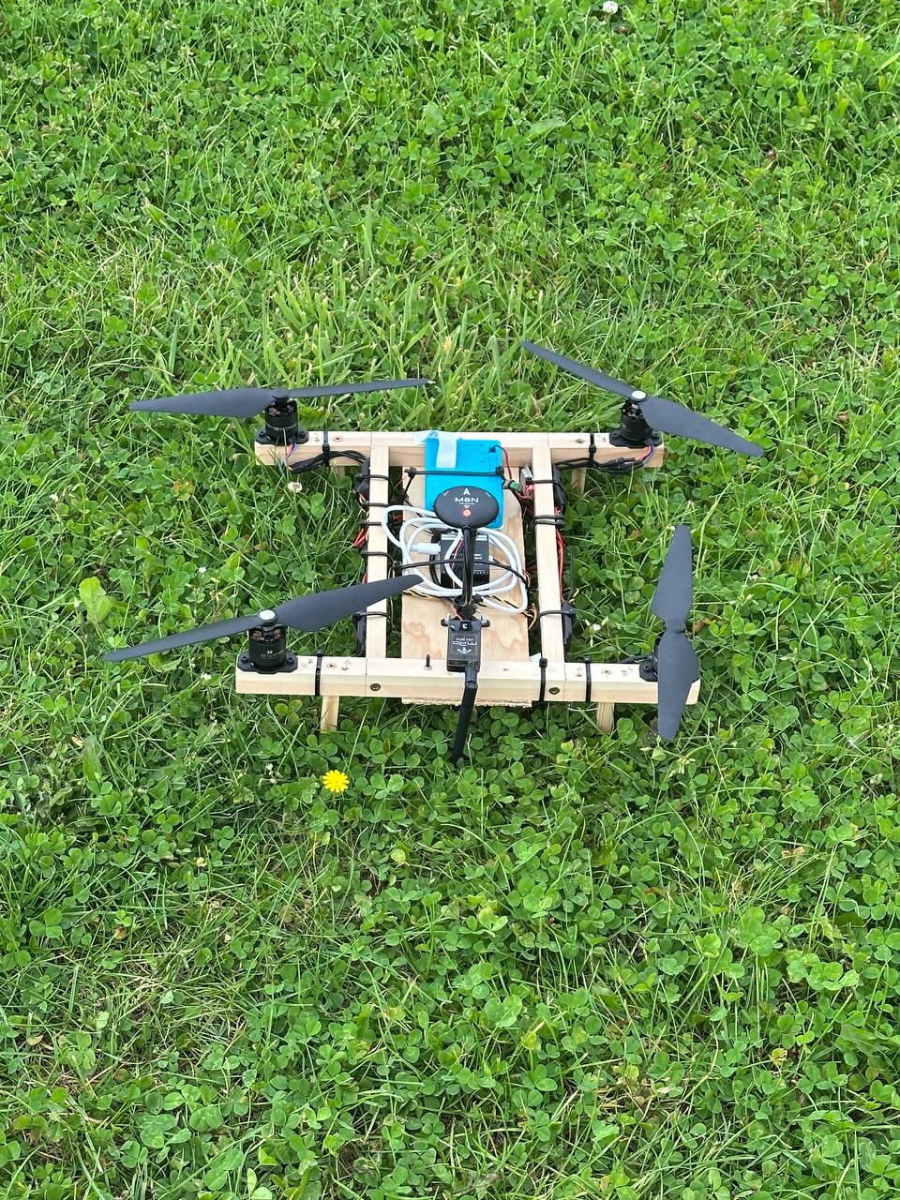
Agenda
Introduction
Construction
Computer Vision
Safety and regulations
Ethics reflections
Conclusion
Slide 1 Group 3 – 16.08.2024

Slide 10
Template-Title
Subtitle
Text
Picture
Slide 1 Group 3 – 16.08.2024

